Slide 1


Framework for
Accelerating Improvement
Paula Griswold, MS
Executive Director,
MA Coalition for the Prevention of Medical Errors
Patricia McGaffigan, RN, MS, CPPS
Vice President, Patient Safety Programs
President, Certification Board for Professionals in Patient Safety
IHI/NSPF

Slide 2
ECRI Top Patient Safety Concerns for 2018
Diagnostic errors
Opioid safety across the continuum of care
Internal care coordination
Workarounds
Incorporating health IT into patient safety programs
Management of behavioral health needs in acute care settings
All-hazards emergency preparedness
Device cleaning, disinfection, and sterilization
Patient engagement and health literacy
Leadership engagement in patient safety

Slide 3
Which are projects/clinical goals and which are organizational strategies?
Diagnostic errors
Opioid safety across the continuum of care
Internal care coordination
Workarounds
Incorporating health IT into patient safety programs
Management of behavioral health needs in acute care settings
All-hazards emergency preparedness
Device cleaning, disinfection, and sterilization
Patient engagement and health literacy
Leadership engagement in patient safety

Slide 4
Which are organizational strategies?
Diagnostic errors
Opioid safety across the continuum of care
Internal care coordination
Workarounds
Incorporating health IT into patient safety programs
Management of behavioral health needs in acute care settings
All-hazards emergency preparedness
Device cleaning, disinfection, and sterilization
Patient engagement and health literacy
Leadership engagement in patient safety

Slide 5

Organizational Strategies to
Accelerate Improvement: Goals
Integrate performance improvement goals
  Patient safety:
  providing effective care – do the right thing every time
  Quality /evidence-based care
  Patient-centered care
  Efficiency – reducing waste/improving value
  Worker Safety
  Reduce Clinician/staff burnout – reducing wasted time
  Joy and Meaning in work - engaging staff in change
  Across system - Care coordination

Slide 6
Organizational Strategies to
Accelerate Improvement: Goals
Integrate performance improvement goals
“Quality” as a business strategy
Meeting customers’ needs without waste

Slide 7
Organizational Strategies to
Accelerate Improvement: Approach
Integrate/align performance improvement resources (no siloes)
  Quality
  Safety/Risk management
  Performance improvement
  Patient experience/patient relations
Decentralize – own the improvement work within units and departments

Slide 8
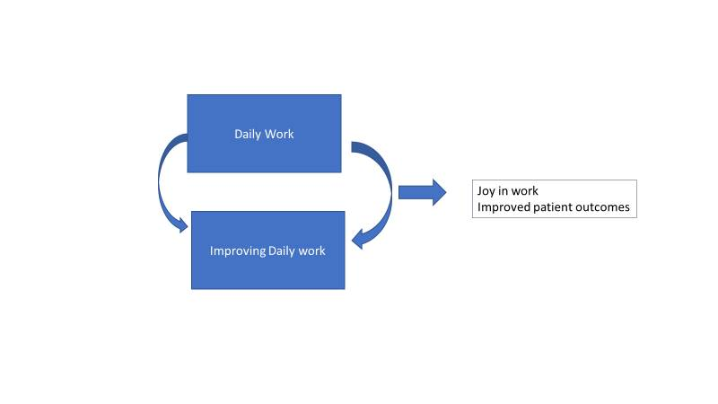

Slide 9
What drives good or bad outcomes for patients?
Daily work – everyday operations:
1. Culture
2. System Design
- are work processes well designed?
- are defined work processes followed?
Patient
Outcomes
Improving daily work:
1. Culture including commitment to safety
and continual learning
2. “See problems”
3. “Solve problems”

Slide 10

Strategies for Accelerating Improvement: Framework
Leadership
Culture
Learning System for Process Improvement
Patient and Family Engagement

Slide 11


To build systems of safety across the continuum of care

Slide 12
Safety as a System Property
Understanding and application of a systems approach enables us to:
  Move from continual churn of “projectitis”
  Focus on doing the right work in the right way
  Delivering value; eliminating waste
  Ensuring safe, reliable, and effective care

Slide 13

Framework for Safe, Reliable, and Effective Care
Psychological Safety
Accountability
Culture
Leadership
Teamwork &
Communication
Engagement of Patients & Family
Transparency
Negotiation
Reliability
Continuous Learning
Improvement
&
Measurement
Learning System
© IHI and Safe and Reliable Healthcare
Frankel A et al. A Framework for Safe, Reliable, and Effective Care. White Paper. Cambridge, MA: Institute for Healthcare Improvement and Safe & Reliable Healthcare; 2017.

Slide 14
Achieving Results at a System Level: Will, Ideas, Execution
Will to Improve
Ideas for Alternatives
Execution to Make It Real
Nolan TW. Execution of Strategic Improvement Initiatives to Produce System-Level Results. IHI Innovation Series While Paper; 2007

Slide 15
Quality as a Business Strategy (QBS)
Aim: To enable an organization to produce products and services that will be in demand and to provide a place where people can enjoy and take pride in their work
  Foundation of continuous matching of products and services to a need with ongoing design and redesign
  Organization performs as a system to meet needs
  Set of methods to ensure that changes result in real improvements to the organization
Associates in Process Improvement (API). Quality as a Business Strategy: An Overview. 2008.

Slide 16
QBS Leadership Essentials
Constancy of purpose
Viewing the organization as a system
Obtaining information about needs of customers
Planning for improvement
Managing improvement efforts

Slide 17

Highly Adoptable Improvement
Intervention design
  Workload
  Complexity
  Efficacy
Implementation Strategy
  End-user participation
  Alignment and planning
  Resources
Hayes W, Goldman D. Highly Adoptable Improvement: A Practical Model and Toolkit to Address Adoptability and Sustainability of Quality Improvement Initiatives. Joint Commission Journal of Quality and Safety. 44 (3): March 2018: 155-163.

Slide 18

Touchstone
A test or criterion for determining the quality or genuineness of a thing; any physical or intellectual measure by which the validity of a concept can be tested

Slide 19

Where do you see the touchstones today?
Constancy of purpose
Viewing the organization as a system
Obtaining information about needs of customers
Planning for improvement
Managing improvement efforts

